Slide 1
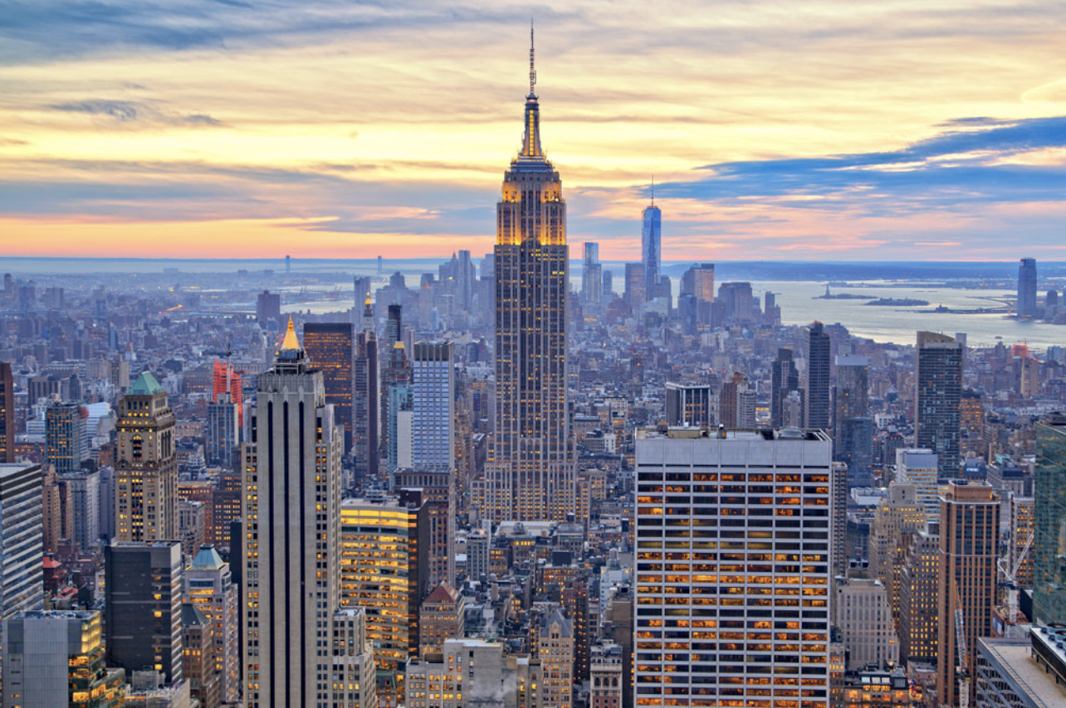


The Big Apple Filming Trail
Ranjeeta Bhattacharya

Slide 2



Background
New York City or The Big Apple is considered one of the greatest cities in the whole world having a cinematic identity that touches upon all walks of life. Some of the most iconic movies, television series, documentaries, short films, dramas, theatres, etc. have all revolved around this bustling metropolis. Let’s try and follow the Big Apple filming trail by exploring the following areas:
What are some of the most popular filming locations? Is there a change in preference over the years?
Major categories and subcategories of filming?
International movie filming statistics?
Which month witnesses maximum filming typically?
Which borough has maximum parking reservations for filming?
What is the filming trend borough wise over the years?
Top 3 filming categories?
Most preferred shoot start time hour of a day?
Different types of permit handed over?
Total number of hours of shoot for a particular category over the
period of yours for each borough?

Slide 3



Data Collection & Preprocessing
Data source NYC Open Data portal
Dataset Link [URL]
Year 2014 – 2019
~43K Rows
14 Columns
Records with invalid zip code removed (~ 10)
Dataset published on June 2019 considered for exploration

Slide 4
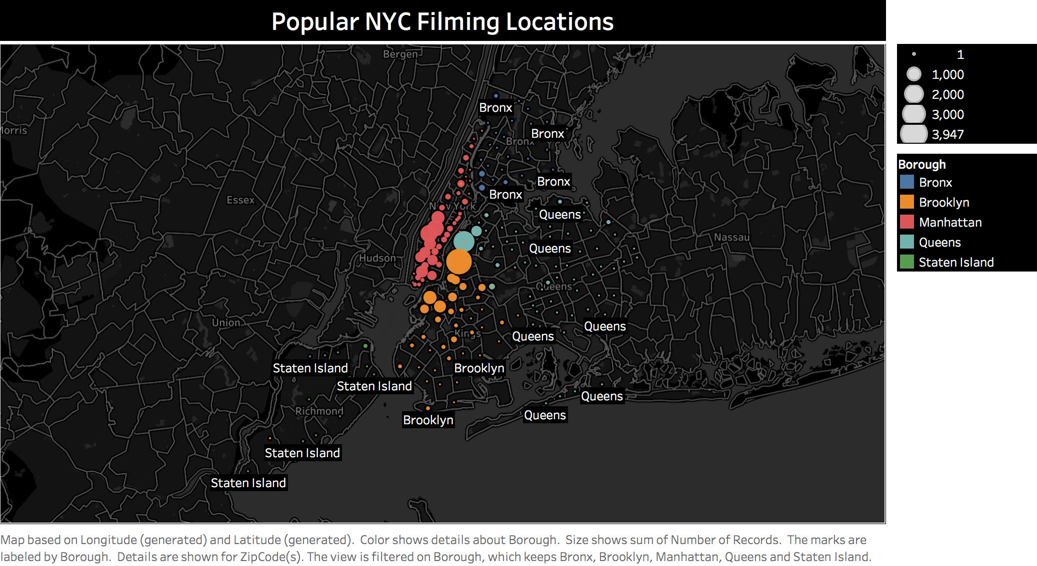
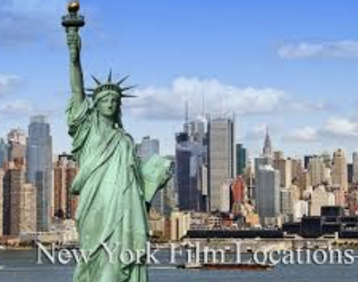

Slide 5
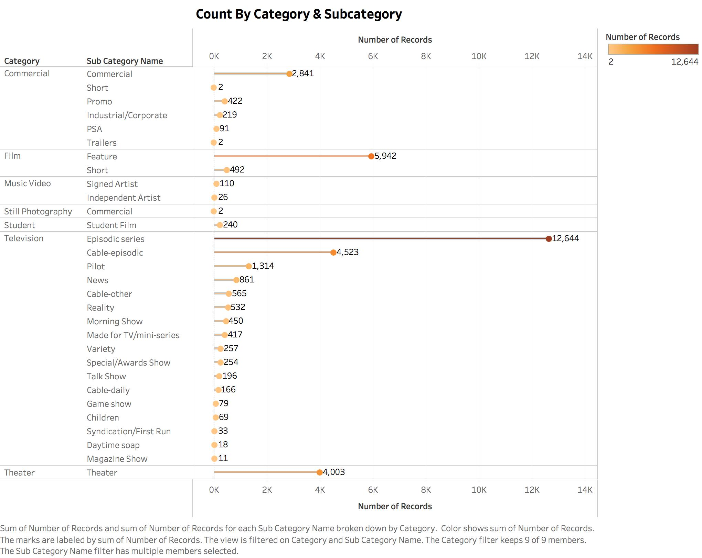


Slide 6
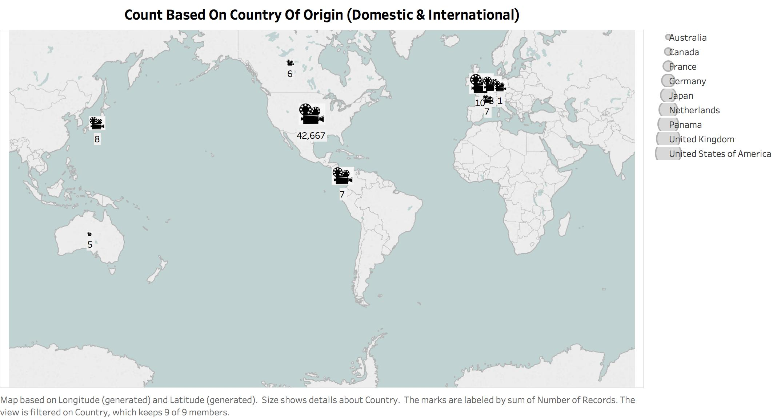


Slide 7
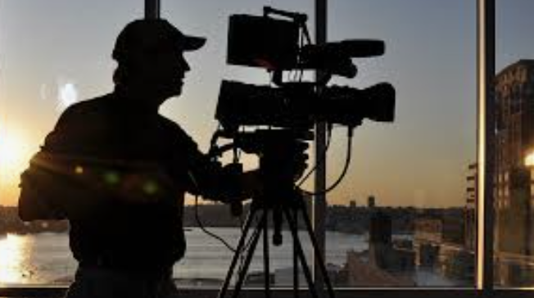
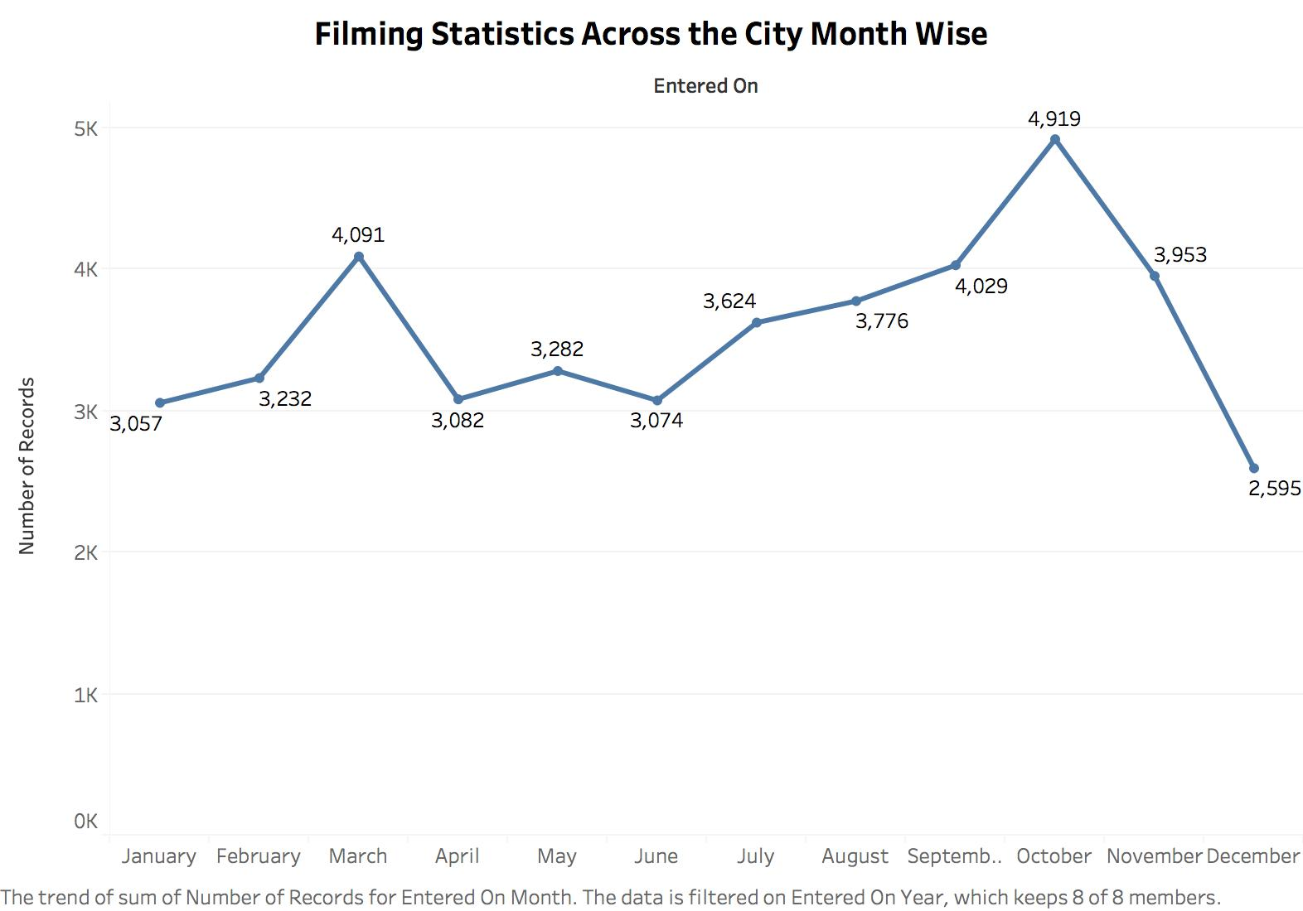


Slide 8
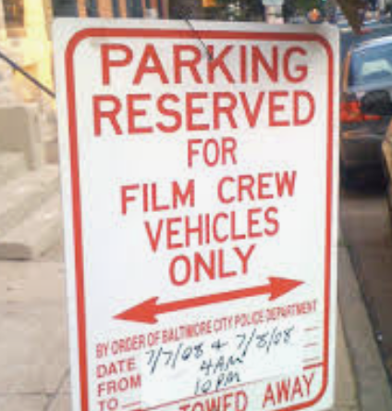
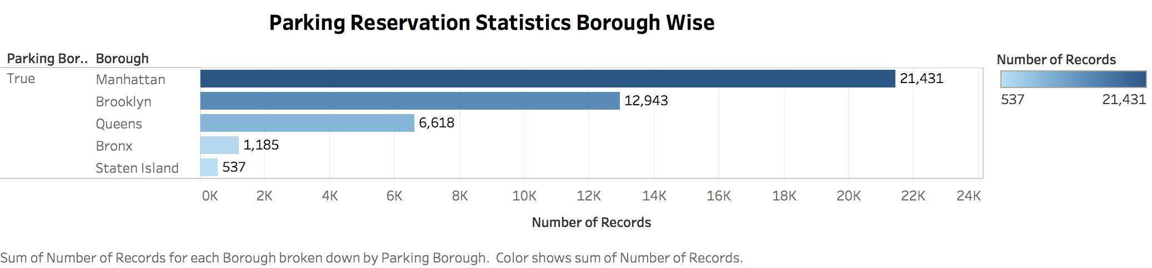

Slide 9
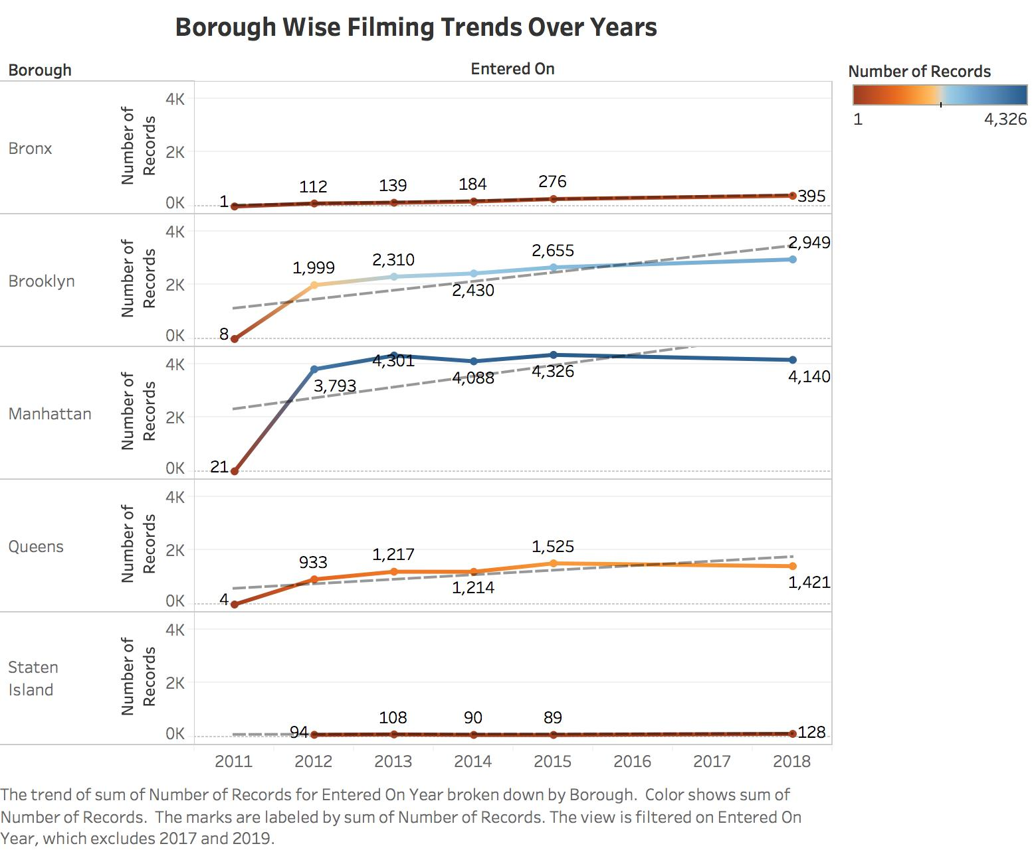
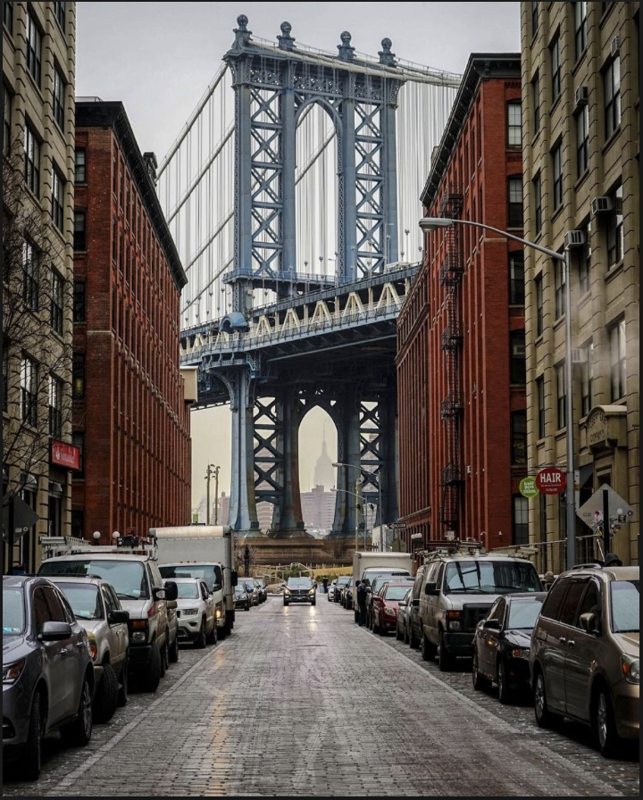
Brooklyn On The Rise….

Slide 10
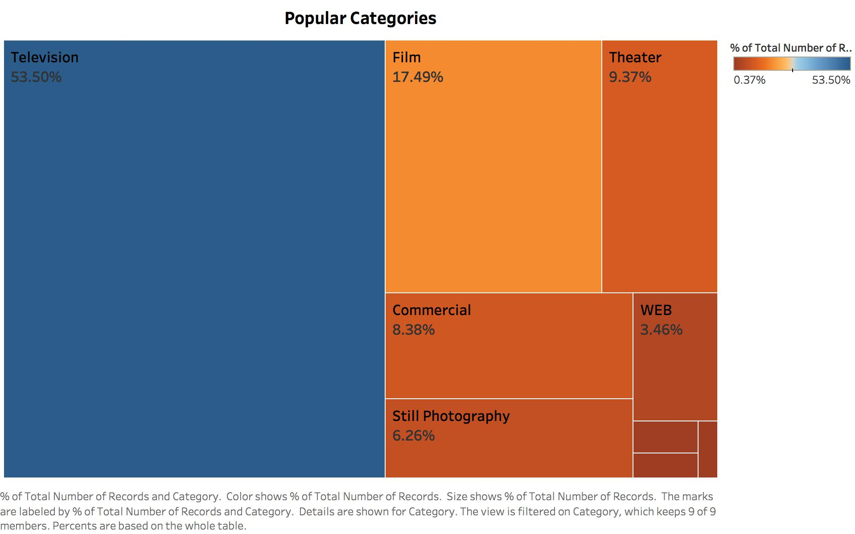





Slide 11
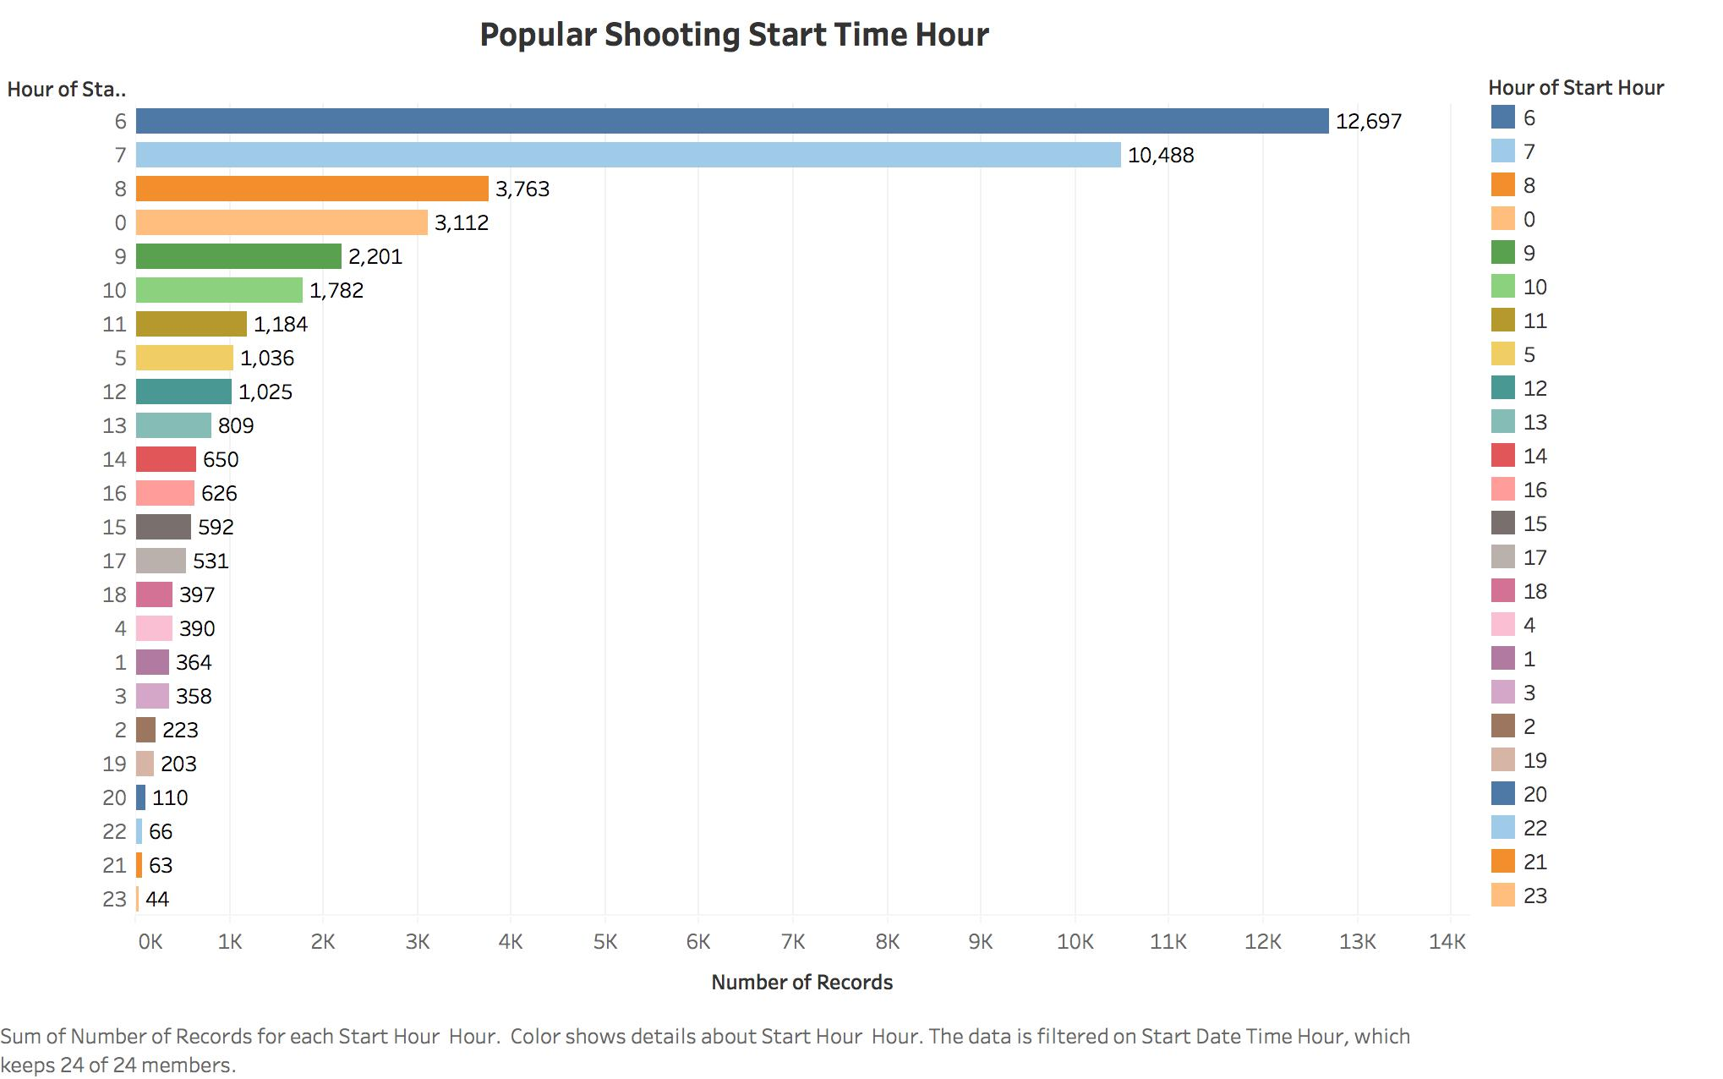
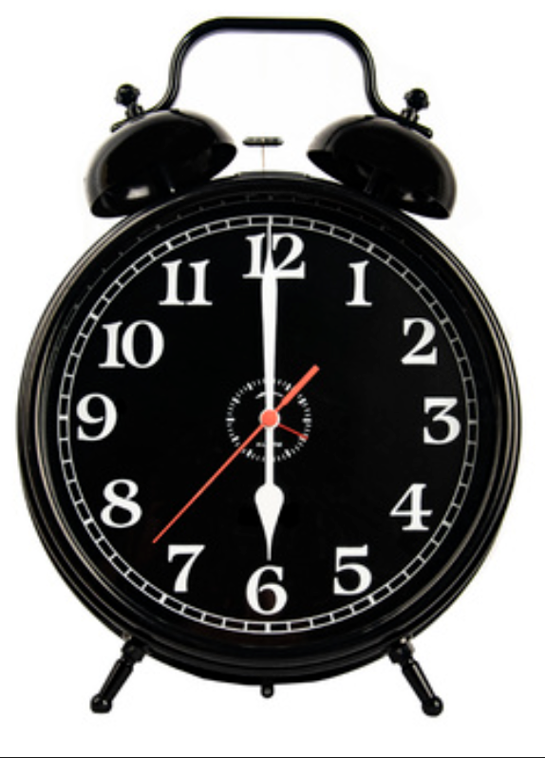
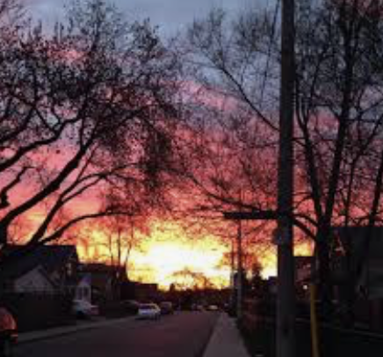
Morning Shows The Day..

Slide 12
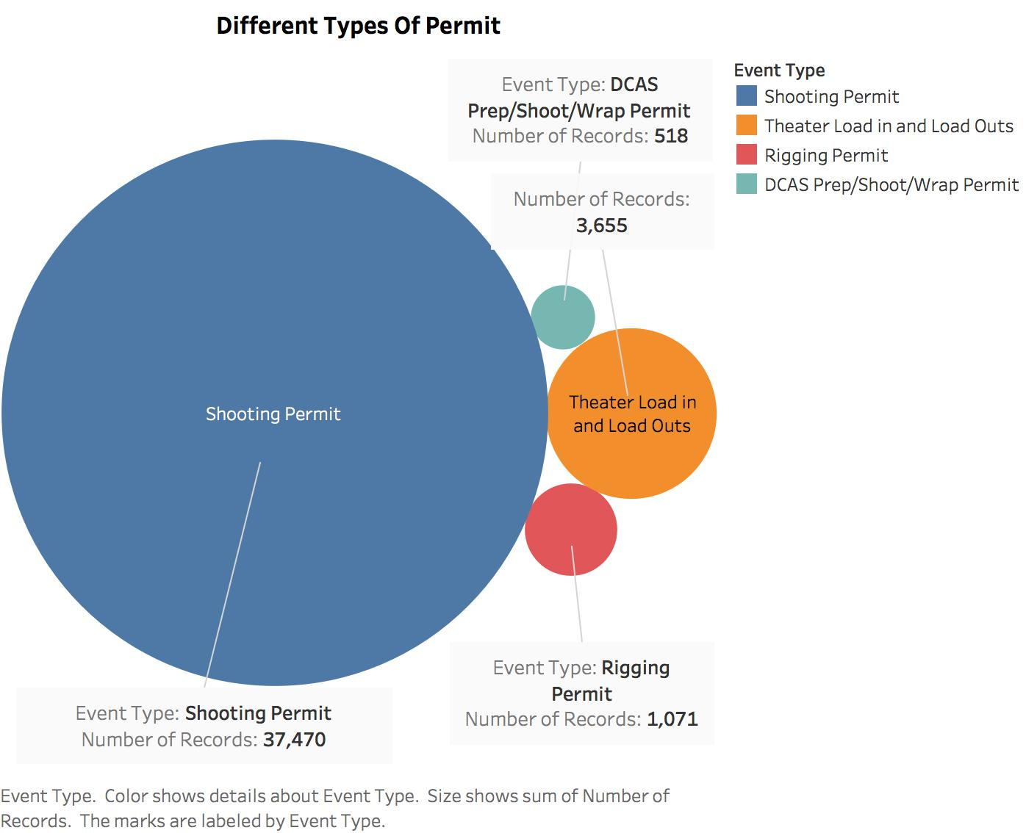
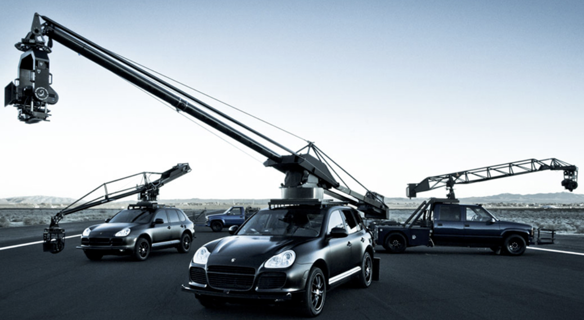

Slide 13

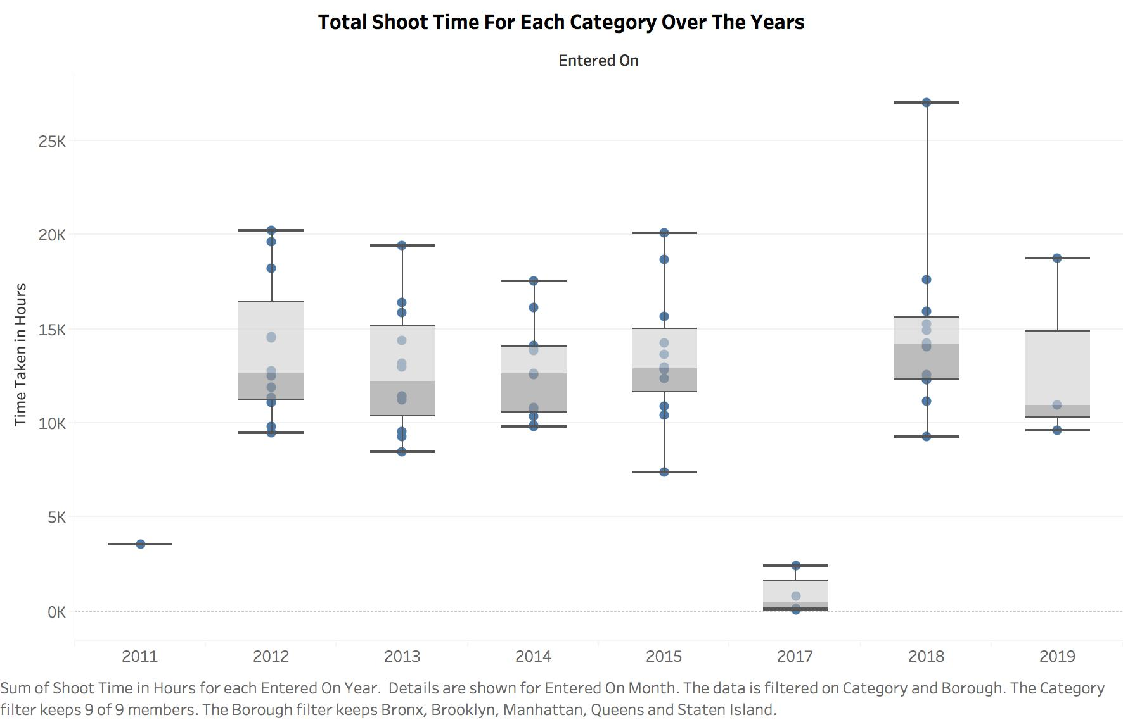

Slide 14
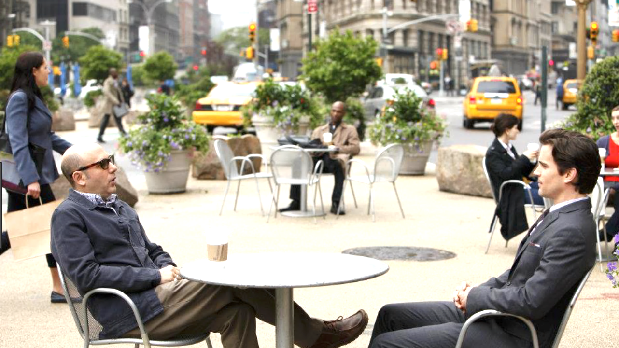
Conclusion & Future Scope
Maximum filming in Manhattan (midtown and downtown) followed by Brooklyn and Queens.
Television is the most popular shoot category followed by films and theatre.
Top three subcategories includes episodic series, feature films and theatre.
International shoots mostly includes films from the United Kingdom, Japan, France etc.
Fall season (October) is the most preferred filming month.
Maximum parking reservations is done in Manhattan borough wise. Brooklyn is far second.
Filming trends borough wise over the years 2014 – 2019 shows a steep rise in popularity of Brooklyn compared to other boroughs.
Early morning time (6 – 7 AM) is the preferred slot for starting filming.
2018 was the busiest year in terms of hours of filming activity in the city. Overall trend remains upward.
Attribute parking held (string location) can be converted to corresponding latitude and longitude coordinates using google geocoding API which can be plotted on the city map. This is future scope.
Other external datasets related to movie ratings, film scene locations etc. can be merged with the existing data to gather further interesting insights. This is future scope.

Slide 15
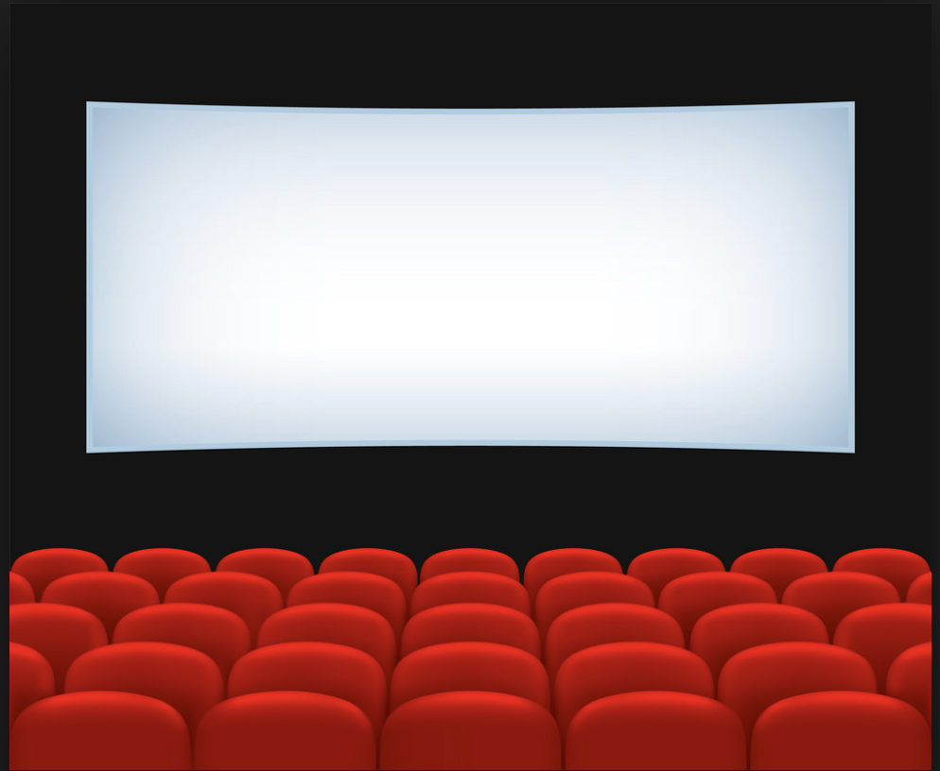

Thank You!

